Slide 1

Introduction to BDD using Specflow

Slide 2
Course Overview
In this course we will:
See What is BDD and Specflow Introduction
Set Up Specflow with Unit/UI test in Visual Studio
Specflow Basics
Data Driven Testing
Specflow advanced features
Specflow best practices

Slide 3
Section1 - BDD - An Introduction
Test Driven Development (TDD)
Module Driven Development (MDD)
Acceptance Test Driven Development (ATDD)
Behaviour Driven Development (BDD)

Slide 4
Test Driven Development (TDD)
An iterative development process.
Three activities are tightly interwoven: coding, testing and design.
Each iteration starts with a set of tests written for a new piece of functionality
In the next phase of the iteration, Application code is written with an intention to pass all the tests written earlier in the iteration.
Once the application code is ready tests are run.

Slide 5
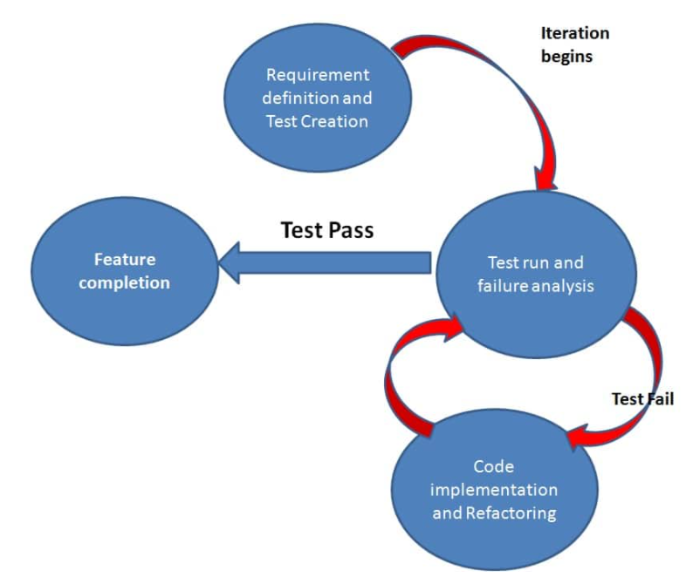
Test Driven Development (TDD) Contd..

Slide 6
Benefits of TDD
Unit test proves that the code actually works
Significant reductions in defect rates
Reduction in effort in projects’ final phases
Higher degree of “internal” or technical quality
Improving the metrics of cohesion and coupling

Slide 7
Drawbacks of TDD
Partial adoption
Poor maintenance of the test suite
Developer can consider it as a waste of time
Test become part of the maintenance overhead of a project
Rewrite the test when requirements change
Writing tests that are too large or coarse-grained

Slide 8
Model Driven Development (MDD)
Focuses on the construction of a software model
The model is a diagram that specifies how the software system should work before the code is generated.
It can be tested using model-based testing (MBT) and then deployed.
Raise the level of abstraction for application development

Slide 9
Benefits of MDD
The MDD approach provides advantages in productivity over other development methods because the model simplifies the engineering process. It represents the intended behaviors or actions of a software product before coding begins.
Reduce development time and improve application quality
Reduce maintenance cost and Total Cost of Ownership of enterprise applications
High collaboration
Tests, rebuilds and redeployments can be faster

Slide 10
Drawbacks of MDD
Time consuming occupation
High rigidity
Far from flexible
The requirement team needs to understand what is allowed and what not
Version control system

Slide 11
Behaviour Driven Development (BDD)

Slide 12
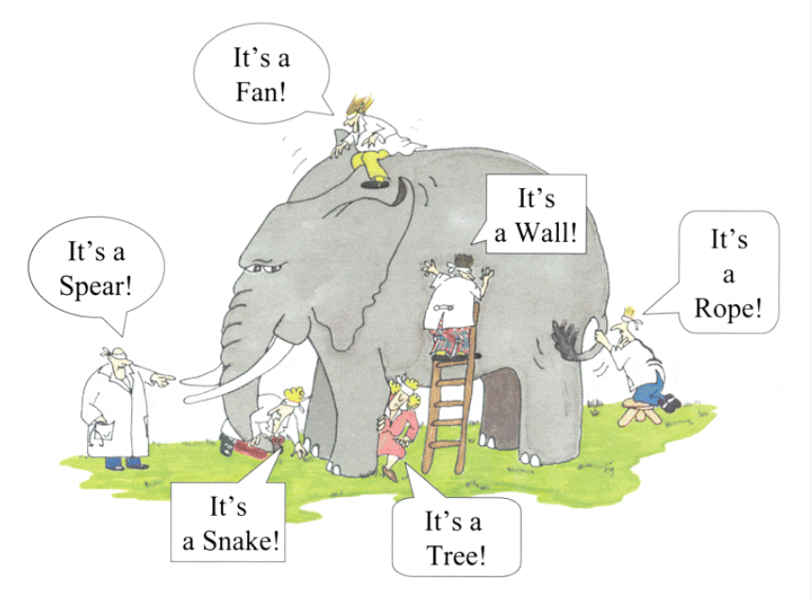
Wrong Perception

Slide 13
Behaviour Driven Development (BDD)
Behavior Driven testing is an extension of TDD.
The major differences :
Tests are written in plain descriptive English type grammar
Tests are explained as behavior of application and are more user-focused
Using examples to clarify requirements

Slide 14
Features of BDD
Shifting from thinking in "tests" to thinking in "behavior“
Collaboration between Business stakeholders, Business Analysts, QA Team and developers
Ubiquitous language, it is easy to describe
Driven by Business Value
Extends Test-Driven Development (TDD) by utilizing natural language that non-technical stakeholders can understand

Slide 15
Acceptance Test Driven Development (ATDD)
Acceptance Test-Driven Development is very similar to Behavioral-Driven Development.
However, a key difference between them is: BDD focuses more on the behavior of the feature, whereas ATDD focuses on capturing the accurate requirements.
Some of the key practices in ATDD:
Analyzing and discussing the real-world scenarios
Deciding the acceptance criteria for those test scenarios
Automating the acceptance test cases
Focusing on the development of those requirement cases

Slide 16
Key Differences: TDD vs BDD vs ATDD
Parameters | TDD | BDD | ATDD
Definition | TDD is a development technique that focuses more on the implementation of a feature | BDD is a development technique that focuses on the system’s behavior | ATDD is a technique similar to BDD focusing more on capturing the requirements
Participants | Developer | Developers, Customer, QAs | Developers, Customers, QAs
Language used | Written in a language similar to the one used for feature development (Eg. Java, Python, etc) | Simple English, (Gherkin) | Simple English, Gherkin
Main Focus | Unit Tests | Understanding Requirements | Writing Acceptance Tests
Tools used | JDave, Cucumber, JBehave, BeanSpec, Gherkin Concordian, FitNesse | Gherkin, Dave, Cucumber, JBehave, Spec Flow, BeanSpec, Concordian | TestNG, FitNesse, EasyB, Spectacular, Concordian, Thucydides

Slide 17
Section2 – BDD Implementation with Specflow

Slide 18

Benefits of business readable automated tests
“Build the right thing and build it right”
Types of tests that can be written with SpecFlow
Possible SpecFlow workflows Living documentation
High level overview of how SpecFlow works
SpecFlow technical features
Why Use Specflow

Slide 19
Business readable automated tests
Tests that run automatically to verify a system is working as expected, and that document the system in a way that non-technical people can understand and contribute to.

Slide 20



Why Business Readable Automated Tests?
Document
Execute
Communicate

Slide 21
Help document:
What features does the system have?
How do those features work?
What different usage scenarios does the system support?
What does the system not support?
Lives alongside source code New developers
New business people Audit

Slide 22
Executable
Checks the system is behaving as expected Documentation is “living”
Stays in sync with actual code
Business readable documentation maps to executable test code

Slide 23
Enables better communication between development team and business
Common (high-level) language Generally non-technical
Ensure correct features are being built
Ensure different usage scenarios are covered

Slide 24
Types of Automated Tests
Unit
Integration
API
Functional UI

Slide 25

SpecFlow can sit on top of any type of automation test code you are currently writing

Slide 26
SpecFlow Workflows
BDD
ATDD
Add SpecFlow tests to existing code
Not “all-or-nothing” approach Start with communication “gaps”

Slide 27





Example Workflow
SpecFlow Scenarios
Whole Team
Whole Team
Review
Coding
All Test Pass

Slide 28

Source code exists in source control system
Truth of what the system does
Documentation in separate place
Word documents on
network share
Documents in SharePoint

Slide 29
Uncertainty or ambiguity in requirements or specifications can lead to wasted time and effort of business people, developers and testers and may impact team happiness in a negative way.

Slide 30

Source code exists in source control system
Specifications exist alongside source code
Single truth of what the system does
Specifications (tests) can be executed
May still have supporting documents

Slide 31





High Level SpecFlow Overview
Test automation code
Generate or hand code
Assert.Equal(…)
Testing Framework MSTest
NUnit xUnit.net
SpecFlow Feature File
Methods (.cs)

Slide 32
Organize scenarios into features file
Support for many different spoken languages
Map automation code by method name convention or regular expressions
Share code steps between scenarios
Add arbitrary tags to organize and execute Create reusable steps that use parameters Replace repetitious scenarios with tables Customizable step parameter data conversion Use dynamic types to reduce code
Run additional setup/clean-up code
SpecFlow Technical Features Overview

Slide 33
“Build the right thing and build it right”
Unit, integration, API, UI
ATTD, BDD, retrofit to existing code
Living documentation
High level overview of how SpecFlow works (feature file → step methods)
SpecFlow technical features
Summary

Slide 34
Section3 – Specflow fundamentals

Slide 35
Feature headers
Understanding feature files
Overview
Scenario steps (“given”, “when”, “then”)
Comments and tags in feature files Step definition code
Installation overview and NuGet packages Getting started in Visual Studio
Step definition binding styles

Slide 36
Feature File Structure
Feature File
Header
Name and description of feature
Scenario Step Step Step
Scenario name
Logical steps (high level / business oriented)
Scenario
Step
Step

Slide 37
Feature: Credit Card Properties
As a new credit card holder
I want my credit card attributes to be correctly represented
Feature: PlayerCharacter
In order to play the game As a human player
I want my character attributes to be correctly represented
Header
Feature name
Free textual description of the feature Any format / number of lines

Slide 38
Feature: Credit Card Properties
In the current world, the volume of credit cards are increasing at an exponential rate. This is very critical to have all the card information should be secured in a well defined manner, for example Credit card should be active after creation.
Feature: PlayerCharacter
In order to play the game As a human player
I want my character attributes to be correctly represented
Format-less header

Slide 39



Writing Feature Headers
Who benefits or is interested in this feature?
What is required/necessary?
Why is this feature important/valuable?

Slide 40
Length / brevity
Long enough to hold enough detail, not so long as no one bothers to read it
Be specific about the "who"
"HR manager", rather than "user"
Adjectives bring things to life
"Busy HR manager" or "Frustrated HR manager"
Use a format (or formats) that increase ease of communication for all readers
General Guidelines

Slide 41
“[Gherkin] … is a Business Readable, Domain Specific Language that lets you describe software’s behaviour without detailing how that behaviour is implemented.”
https://github.com/cucumber/cucumber/wiki/Gherkin

Slide 42
Gherkin Steps
Scenario Step Step Step
Given - Setup starting state of system
When - Describe the action that takes place Then - Observe and verify outcome / end state

Slide 43
Scenario: Credit card should be active after creation
Given I have a credit card
When credit card limit is 50000 USD
Then credit card should be active
Given, When, Then

Slide 44
Scenario: Credit card should be active after creation Given I have a credit card When credit card limit is 50000 USD
Given Card has not entered the SSN
When transaction is done
Then Transaction should get failed Then Card should not be activated
And, But

Slide 45
Scenario: Credit card should be active after creation
Given I have a credit card And credit card limit is 50000 USD
But Given Card has not entered the SSN
When transaction is done
Then Transaction should get failed
And Card should not be activated
And, But
Can use in Given, When, or Then phases Improves readability / fluentness

Slide 46
Scenario: Starting health
# This scenario is a common one
Scenario: Starting health
Given I'm a new player
# All players start with 100 health
When I take 40 damage
Then my health should now be 60
Comments
Lines that start with #

Slide 47
@health @fighting Scenario: Starting health
# This scenario is a common one
Scenario: Starting health
Given I'm a new player
When I take 40 damage
Then my health should now be 60
Tags
Additional way to organize features and scenarios Feature or scenario level Can have multiple tags set

Slide 48
@health @fighting Scenario: Starting health
# This scenario is a common one
Scenario: Starting health
Given I'm a new player
When I take 40 damage
Then my health should now be 60
Feature Level Tags
Apply at feature level
Inherited by all scenarios in file

Slide 49
Step Definition Code
PlayerCharacter.feature PlayerCharacterSteps.cs
Scenario
Step definition binding
Given
public void Given…
public void When… public void Then…
When
Then

Slide 50
Step Definition Binding Styles
Regular
Expression
Method
Naming Convention
Use attribute on method to bind Level of indirection
Method names can be anything Refactoring of method names Extra attribute code
Method name matches convention Underscore or Pascal case
Method names match step text Harder refactoring
Less attribute code

Slide 51

Underscore Step Binding Style
[Given]
public void Given_I_m_a_new_player()
{
_player = new PlayerCharacter();
}

Slide 52
Pascal Case Step Binding Style
[Given]
public void GivenIMANewPlayer()
{
_player = new PlayerCharacter();
}

Slide 53
Regular Expression Step Binding Style
[Given(@"I'm a new player")]
public void GivenIMANewPlayer()
{
_player = new PlayerCharacter();
}

Slide 54
Regular Expression Step Binding Style
[Given(@"I'm a new player")]
public void Xyz()
{
_player = new PlayerCharacter();
}

Slide 55
Set up Specflow in Visual studio 2019

Slide 56
Installation Overview
Testing Framework NuGet Packages
SpecFlow Visual Studio Extension
SpecFlow NuGet Packages
IDE Integration
Generate step definitions
Editor autocomplete
SpecFlow package
SpecFlow testing framework integration
Separate testing framework
Used for writing test code
E.g. Assert.Equal

Slide 57

Demo
Create CCSpecFlow test project
Install SpecFlow Visual Studio extension Install SpecFlow.xUnit NuGet package
Install xunit.runner.visualstudio NuGet package
Add SpecFlow feature file
Getting Started in Visual Studio

Slide 58
Demo
Using SpecFlow tool options
Generate step definitions Regular expression style Underscore style
Pascal case style Previewing step definitions
Copying step code to clipboard
Step Definition Binding Styles

Slide 59
Practical 1. Set Up Specflow project 2. Writing a new calculator scenario

Slide 61
Feature headers (“who”, “what”, “why”)
Scenario steps (“given”, “when”, “then”) #Comments and @tags in feature files
Summary
Step definition code maps to scenario steps
Installation overview and NuGet packages Getting started in Visual Studio
Generate steps definition class
Copy and preview step definition code
Regular expression, underscore, and Pascal case styles

Slide 62
Day 2 – Specflow fundamentals Writing Basic SpecFlow Tests

Slide 63
Initial demo sample production code Create the first scenario Implement the test automation code Running and debugging test scenarios Adding additional scenarios Add some deliberate duplication Reviewing maintainability Scenario outline using examples
Overview

Slide 64
Demo
Show demo class
Add ref from Dev project
Demo Sample Production Code

Slide 65
Write first scenario
Generate step definition file
Modify to remove parameters
ScenarioContext.Current.Pending();
Write the Actual code and build the solution
Test execution of our first scenario
Demo
Creating the First Scenario

Slide 66
Demo
Run test with Test Explorer
Adding breakpoint in When step Debugging from Test Explorer Using breakpoints in scenarios Step into code from scenario text
Running and Debugging Test Scenarios

Slide 67
Practical 1. Writing a new Scenario Scenario : Credit card should become active after the creation

Slide 68
Demo
Add new scenarios
Initial credit card's balance should be equal to the limit
Initial credit card outstanding amount should be 0
Copy steps to clipboard
Remove parameters
Hand write step definitions Add test automation code
Run new tests
Adding Additional Scenarios

Slide 69
Practical 1. Generate step definition 2. Dev Code linking 3. Debug and Execute the newly added scenarios

Slide 70
Demo
Duplication in scenarios
Scenario steps differ only by data
Code parameterized shared steps
Using the ‘AND’ keyword
Reviewing
Maintainability

Slide 71
Practical 1. Shared steps and Parameters 2. Using ‘AND’ keyword

Slide 72
Scenario Outlines
Scenario outlines allow the same basic scenario to be executed multiple times, each time with different test data.
Using scenario outlines allows the reduction or elimination of repeated scenarios where the only difference between the scenarios are the inputs or expected outcomes.

Slide 73
Refactor 3 scenarios
"Credit card should be active after creation”
“Initial credit card's balance should be equal to the limit”
“Initial credit card outstanding amount should be 0”
Create new Scenario Outline
Add 3 examples
Remove duplicated scenarios
Run tests
Easy to add further examples
Demo
Demo
Refactoring to Use Scenario Outlines
Refactoring to Use Scenario Outlines

Slide 74
Introducing Scenario Outlines
Scenario Outline: Combined Scenario
Given I have a credit card
AND the credit card limit is <limit> USD
Then credit card should be active
And balance should be <balance>
And outstanding amount should be <outstanding>
Examples:
| limit | balance | outstanding |
| 50000 | 50000 | 0 |
| 70000 | 70000 | 0 |
| 90000 | 90000 | 0 |

Slide 75
Practical 1. Scenario outline with Examples

Slide 76
New scenario: “Elf race characters get additional 20 damage resistance”
Implement with “And” steps Run test
Refactor to use a step data table Access rows from Table object*
Demo
Demo
Using Data Tables in Scenario Steps
Using Excel in Scenario Steps
*The next module will cover more advanced / strongly typed data topics

Slide 77
Practical 1. Scenario steps with Excel

Slide 78
Saw initial Credit card class
“Credit card attributes should be properly initialized”
private CreditCard _cc;
Running and debugging test scenarios Added two additional scenarios
Auto generation and manual creation Reviewed maintainability
Duplicated scenario text Duplicated automation code
Scenario outline using examples
Summary

Slide 80
Day 3 – Specflow Advanced

Slide 81
Step argument conversion - Implicit
Built-in automatic / custom transforms
Automatic enum conversion
Strongly-typed step table data Dynamic step table data
Multi column step table data
Context injections
Overview

Slide 82
When I take 100 damage
[When(@"I take (.*) damage")]
public void WhenITakeDamage(int damage)
Step Argument Conversion
Plain text in feature file
Parameters match pieces of text
Plain text (string) → .NET parameter data type

Slide 83
Step Argument Conversion Precedence
Custom Step Argument Transformation
Standard (Inbuilt) Conversion
No Conversion
object, string
Parameter type matches a defined custom transform
Convert.ChangeType() Text → enum value Text → GUID
E.g. int damage

Slide 84
New scenario: “Elf race characters get additional 20 damage resistance”
Implement with “And” steps Run test
Refactor to use a step data table Access rows from Table object*
Demo
Demo
Using Data Tables in Scenario Steps
Using Data Tables in Scenario Steps
*The next module will cover more advanced / strongly typed data topics

Slide 85
Demo
(Need to update)
New MagicalItem class
New Weapon class
New CharacterClass enum
New PlayerCharacter methods / properties
Additions to the PlayerCharacter Class

Slide 86
Demo
(Need to update)
New scenario “Healers restore all health”
Parameterized CharacterClass enum parameter
Standard conversion
Automatic Enum Conversion

Slide 87
Practical 1. Implicit data conversion

Slide 88
Demo
(Need to update) GivenIHaveTheFollowingAttributes code
New PlayerAttributes class in test project Using TechTalk.SpecFlow.Assist; Extension methods on Table class CreateInstance<PlayerAttribute>()
Strongly-Typed Step Table Data

Slide 89
Practical 1. Step table data conversion

Slide 90
Demo
(need to update)
Reduce need for extra test classes
Modify GivenIHaveTheFollowingAttributes Use dynamic C# SpecFlow.Assist.Dynamic NuGet package table.CreateDynamicInstance()
Dynamic Step Table Data

Slide 91
Practical 1. Dynamic step table data conversion

Slide 92
Demo
(Need to update)
New scenario: Total magical power
Table of magical items Weakly-typed code Strongly-typed version CreateSet<MagicalItem>() Dynamic version CreateDynamicSet()
Multi-Column Step Table Data

Slide 93
Practical 1. Step argument conversion with Dynamic set

Slide 94
Strongly typed
Scenario “Elf race characters don't lose magical item power”
“Given I’m a new player” separate step class(need to update)
Null reference exception Store value from Given step Retrieve value in Then step
New PlayerCharacterStepsContext class Add constructor to steps classes Instance provided by SpecFlow
Demo
Using Context Injection
Using Context Injection

Slide 95
Practical 1. Implement the Context injection in the current code

Slide 96
Step argument conversion
Built-in automatic / custom transforms
Automatic enum conversion Strongly-typed step table data Dynamic step table data [StepArgumentTransformation] “3 days ago” → DateTime IEnumerable<Weapon>
(need to update)
ScenarioContext and context injection
Scenario outline using examples from excel file
Summary

Slide 98
Day 4 – Controlling Test Execution and Best practices

Slide 99
Using @tags to execute subsets of tests
Restricting step execution with scoped bindings
Scoped binding rules
Scoped bindings for team workflow
Overview of Hooks
Executing Code Before and After Every Scenario
Hook Execution Ordering
Running additional code with hooks
Overview

Slide 100
Add @elf tag to specific scenarios(need to update)
Build
Test Explorer Traits view
Class view with filter Trait : “elf”
Run all will only run “elf” tests Special ignore tag
@elf @ignore
Demo
Demo
Using Tags to Execute Subsets of Tests
Using Tags to Execute Subsets of Tests
Using Tags to Execute Subsets of Tests

Slide 101
Demo
(need to update)
Different "I take (.*) damage" for elves
New WhenITakeDamageAsAnElf method Ambiguous step definition error
Add [Scope]
Feature, Scenario, tag
Scope step definition to only scenarios tagged with @elf
Restricting Step Execution with Scoped Bindings

Slide 102
[Scope(Tag="elf",
Feature="PlayerCharacter", Scenario="Health reduction")]
[Scope(Tag = "elf")]
[Scope(Feature = "PlayerCharacter")] [Scope(Scenario = "Health reduction")]
Combining Scoped Binding Criteria
Multiple criteria on single [Scope] → AND
Multiple [Scope] attributes → OR

Slide 103
Multiple Matches
Matches regular step definition and scoped step definition
Matches >1 scoped step definition
Scoped definition will be used
Most restrictive step will be used

Slide 104
Be careful with scoped bindings as they can introduce complexity and maintenance overheads.

Slide 105
Practical 1. Need to update

Slide 106
Add scenarios but not implement yet
New feature for game chat
Don’t want to implement until reviewed
Add AwaitingReviewSteps class Add [Binding] attribute
Match all steps
Run → Ambiguous step definitions @awaitingReviewBeforeStartingWork
Add [Scope] to AwaitingReviewSteps class
Demo
Demo
Demo
Scoped Bindings for Team Workflow
Scoped Bindings for Team Workflow
Scoped Bindings for Team Workflow

Slide 107
Overview of Hooks
Before test run starts
Before feature Before scenario
Before scenario block Before step
After step
After scenario block
Feature
Scenario
Given
Given block (phase)
When block
And
When
…
Then
Then block
After scenario After feature
After test run ends
And

Slide 108
Hooks Attributes
Before test run starts
Before feature Before scenario
[BeforeTestRun]
[BeforeFeature] [BeforeScenario] or [Before]
Before scenario block Before step
After step
After scenario block
[BeforeScenarioBlock] [BeforeStep] [AfterStep]
[AfterScenarioBlock]
…
After scenario After feature
After test run ends
[AfterScenario] or [After] [AfterFeature]
[AfterTestRun]

Slide 109
Demo
New Hooks class
[Binding] [BeforeScenario] method [AfterScenario] method Add breakpoints
Debug all tests ScenarioContext.Current.ScenarioInfo
: Steps this.ScenarioContext.ScenarioInfo [BeforeScenario("elf")](need to update)
Executing Code Before and After Every Scenario

Slide 110
[BeforeScenario]
public void BeforeScenario1(){ ... }
[BeforeScenario]
public void BeforeScenario2() { ... }
[BeforeScenario]
public void BeforeScenario3() { ... }
3rd
1st
2nd
Hook Execution Ordering
Multiple hook methods are executed in unspecified order
Specify order

Slide 111
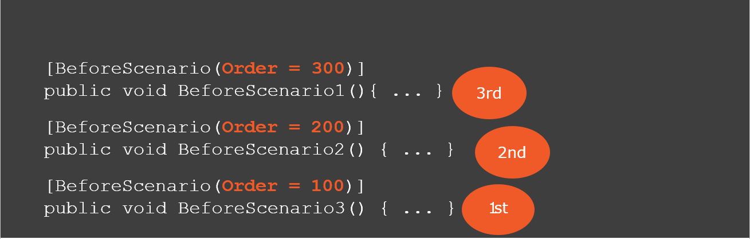
3rd
2nd
Hook Execution Ordering
Specify relative order in hook attribute
Default order value = 1000 Lower order values execute first

Slide 112
Scenario Backgrounds and [BeforeScenario]
Background:
[BeforeScenario]
Ordering
Common “setup” code Relevant to business Not purely automation
Common “setup” code Not business relevant Automation/technical
[BeforeScenario] Then Background

Slide 113
Practical 1. Hooks -Need to update

Slide 114
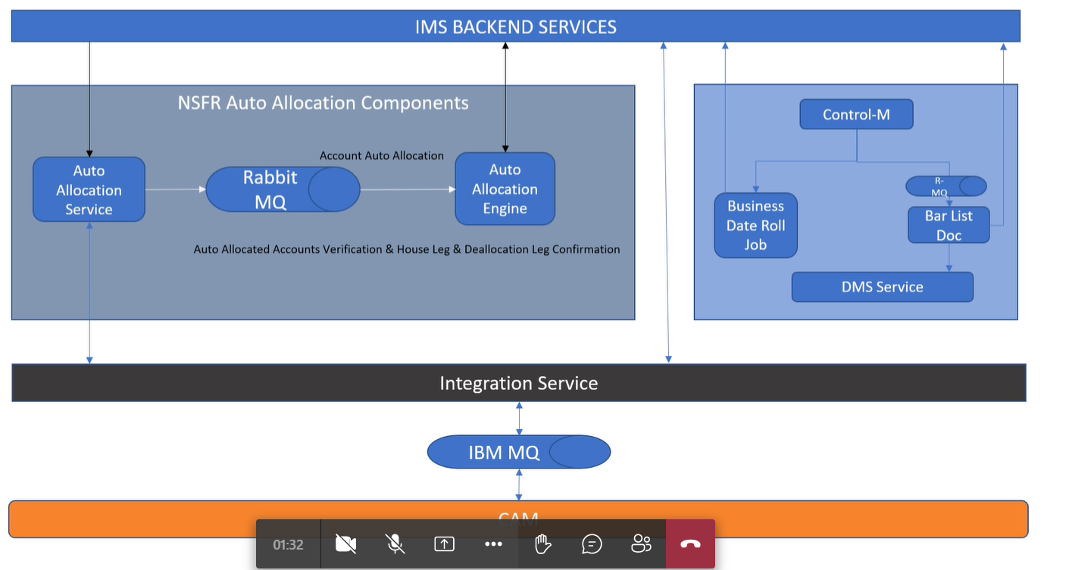
Practical(need to update) Feature file and scenario creation on IMS and Cam

Slide 115
Using @tags to execute subsets of tests
[Scope]
Tag, feature title, scenario title
Scoped binding rules(AND/OR) Scoped bindings for team workflow Running additional code with hooks [BeforeScenario] [AfterScenario]
BDD- Specflow implementation on Project
Summary

